Slide 1
Seriously saving energy at home
Nicola Terry
Transition Cambridge
www.transitioncambridge.org

Slide 2
The current energy crisis
We have a shortage of oil and gas right now
Globally - except for countries willing to buy from Russia
Subsidies will not make more available
Prices rise until demand reduces to match supply
We have to reduce our energy demand
- even if we can afford not to, to keep prices down
Under the price guarantee, high prices->high government borrowing -> high taxes.
The EU is setting targets for member countries to reduce demand urgently – why aren’t we?

Slide 3
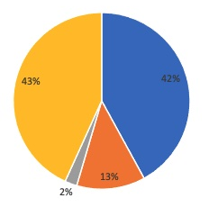
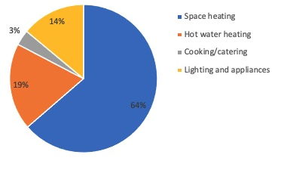
What do you want to save?
Typical bill by cost
Typical bill by gas

Slide 4
How do we reduce demand?
Generate our own energy
Installing PV panels helps (but not much in winter)
Switch to heat pump for heating
Provided SCOP > 2.1, this will use less gas, even if the heat pump uses electricity generated via gas.
Improve efficiency
Avoid waste
Reduce services

Slide 5
How many of you:
Turn down radiators in unused rooms
Have 300mm loft insulation
Have draught stripped your home
Have any single glazed windows
Wait for the hot tap to run hot when you wash your hands
Shower/bath every day – more than 5 minutes?
Notes:
You are probably bored with people giving you the same advice all the time and most of the time you do it already. So hands up if you …

Slide 6
Efficiency: cooler radiators
Condensing boilers are more efficient at lower temperatures (condense more effectively)
Space heating only
Reduce to 55°C or even lower if you can
At lower temperatures, your radiators will put out less heat and it will heat up less quickly when you turn it on
If you can handle 55°C you are heat pump ready!
Can turn it up again if you need to in cold weather.
Combi boilers (others if the controls let you)
Typical savings between 3% and 8% of space heating
Notes:
Here’s one you may not know so much about.

Slide 7
DIY heat savings (annual)
Top up loft insulation to 300mm
From 50mm – cost £7/m² savings £2.90/m²
From 150mm – cost £3/m² savings £0.80/m²
Temporary secondary glazing film
Cost £2/m²
Savings single glazing £5.20/m², double glazing £2.20/m²
Draught proofing
Hard to gauge costs and savings but generally good
Do not block necessary ventilation
Window film- image: https://www.stormguard.co.uk/stormguard-products/seasonal-double-glazing-film/
Notes:
Gas price 10.4p/kWh
Loft insulation savings (gas)
From 50mm 27.7 kWh/m2/year =
From 150mm 8.0 kWh/m2/year
Secondary glazing film savings
50 kWh/m2/year for single glazing = - £5.20
21 kWh/m2/year double glazing = £2.20

Slide 8
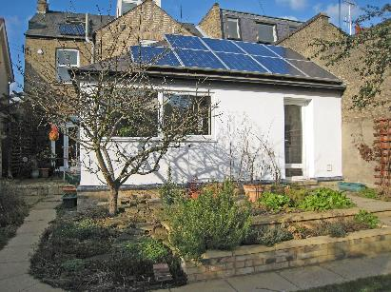
Longer term
Insulation!
Double glazing
Solar PV/battery
Heat pump

Slide 9
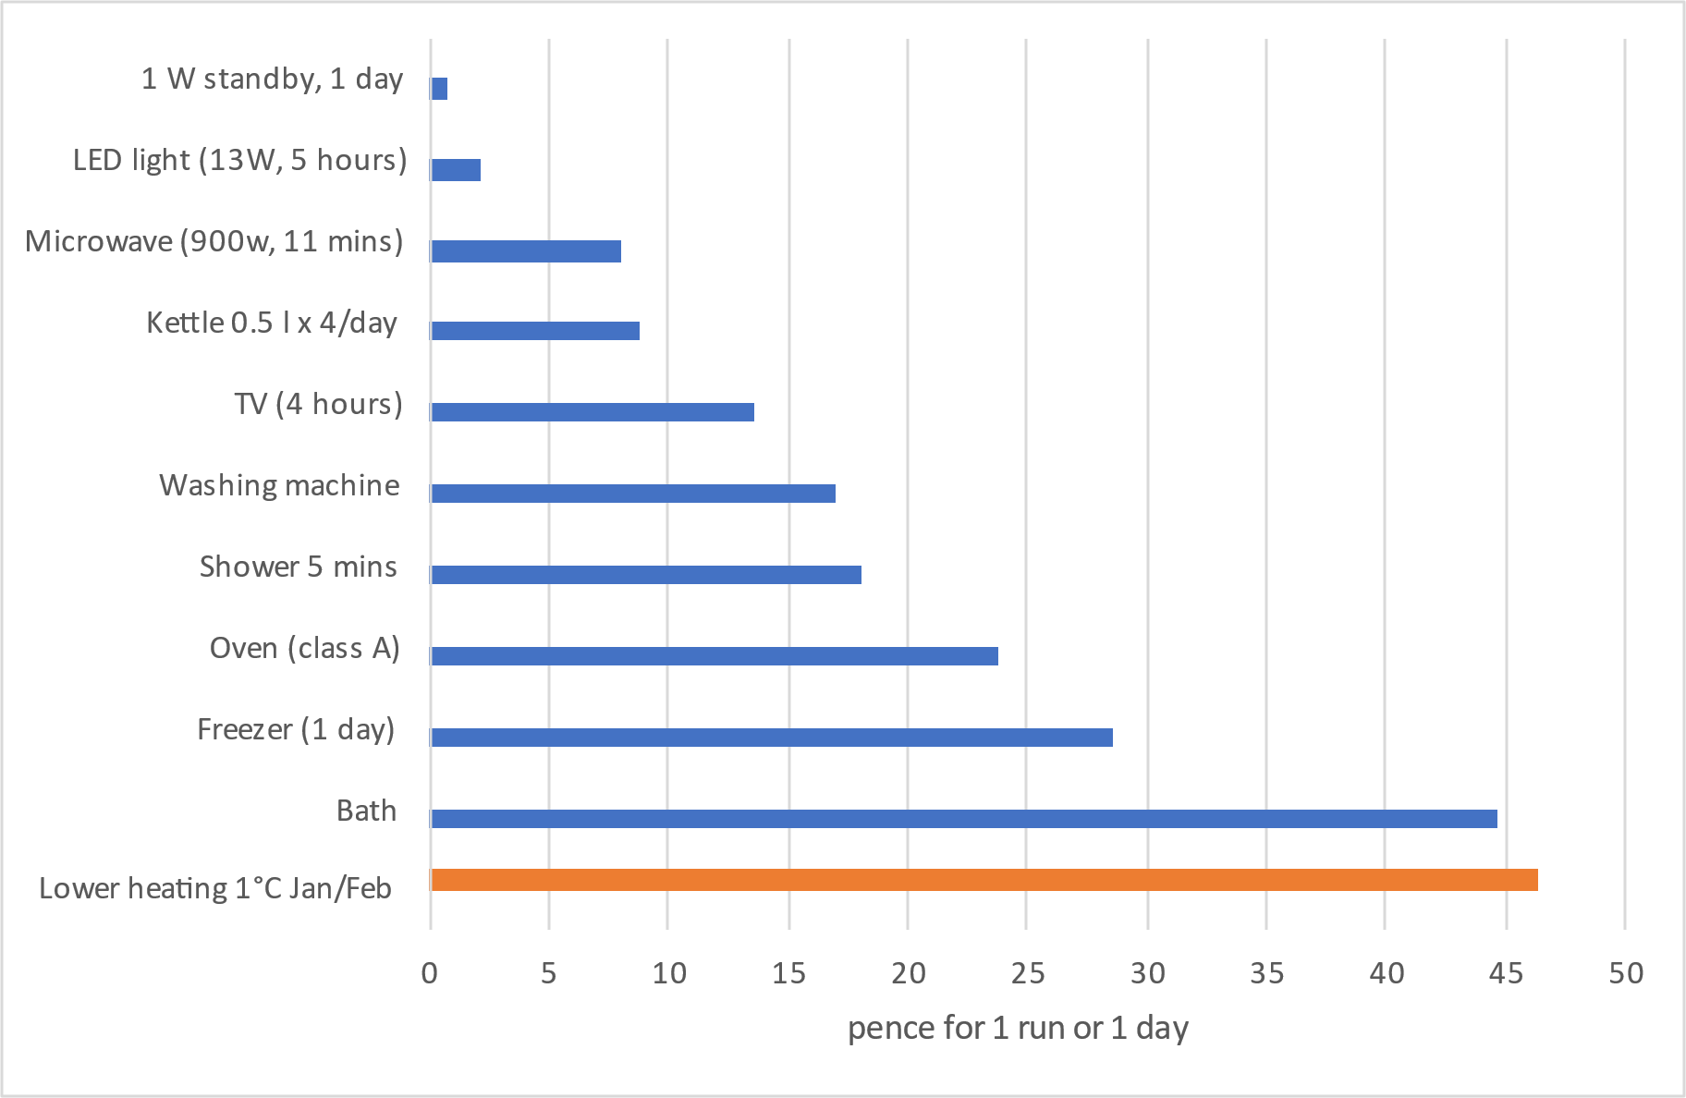
Daily activities - cost
Downloadable spreadsheet with these calculations and more.
Based on gas 10.4p/kWh electricity 34p/kWh
Notes:
This chart shows approximate costs for activities. The bottom line is how much you can save from turning down the thermostat by 1C (A medium size semi-detached, fairly well insulated (EPC C). More savings from bigger/less efficient homes.

Slide 10
Your ideas
Avoid waste
Reduce service
Increase efficiency
Notes:
Ask for their ideas. Will they save a lot or a little?

Slide 11
More information
Come to the stall for more information
Meet Warren Pope, now from Save Money Cut Carbon
Or the website
www.transitioncambridge.org/energy
Lots more ideas on our advice pages
Please fill in our survey (and give us your tips)
Open Eco Homes 12th Sep to 18th Oct.

Slide 12
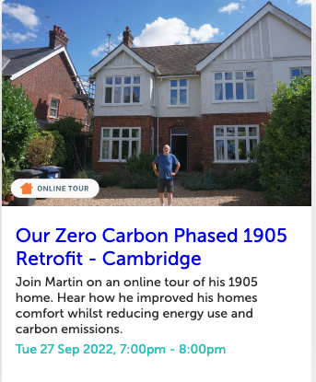
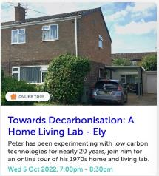
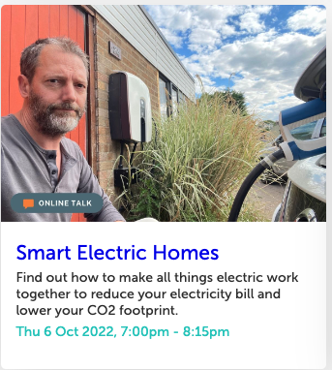
Tours and Talks
(a selection)

